Slide 1
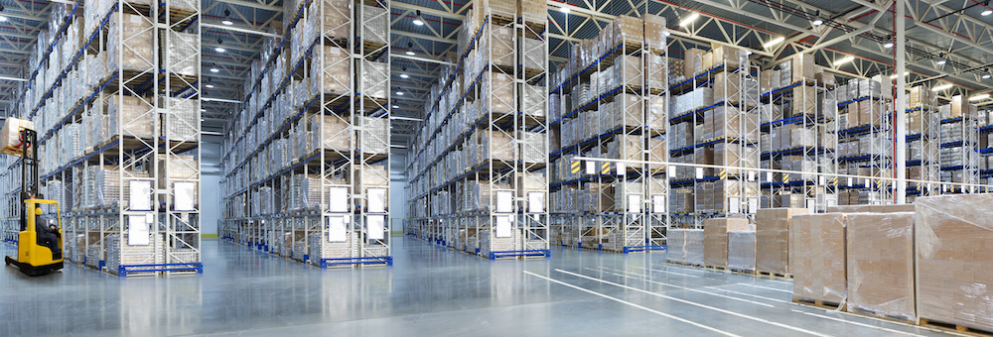


A WAREHOUSE MANAGEMENT DECISION SUPPORT SYSTEM FOR TOTOMAK
Sevde Zümrüt İspay
Melis Karakurt
Burak Kurt
Güner Şirin
Levent Kandiller
Simge Güçlükol Ergin
İrem Amaç
Doğuş Özbaş

Slide 2
CONTENTS
System Analysis (Micro/Macro)
Problem Definition
Modeling Approach and Solution Methodology
Decision Support System (DSS)
Conclusion
2022-2023 Spring - IE 4920 - Group 9 – A Warehouse Decision Support System for Totomak

Slide 3

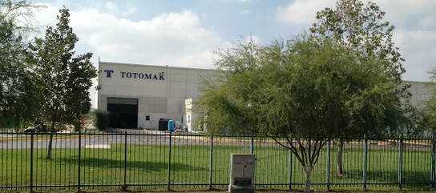
SYSTEM ANALYSIS
2022-2023 Spring - IE 4920 - Group 9 – A Warehouse Decision Support System for Totomak

Slide 4

SYSTEM ANALYSIS
MACRO
Totomak was founded in 1950
Machinery and spare parts company in Çiğli İzmir
95% of Sales → Export
Total Floor Area : 17,500 m² (10,000 m² closed)
Sales Revenue : 51 m EUR (2021), 63 m EUR (2022)
Manpower: 550 employees
Precision Machining: Job Shop
Assembly & Test: Flow Shop
Design: Lean Prototyping & Co-design
Customer Sector Distribution & Global Presence
Automative 16%
Climatization 50%
Heavy Duty Machining 30%
Energy 4%
Manufacturing System
Production Processes
Assembly and Test Lines
2022-2023 Spring - IE 4920 - Group 9 – A Warehouse Decision Support System for Totomak

Slide 5
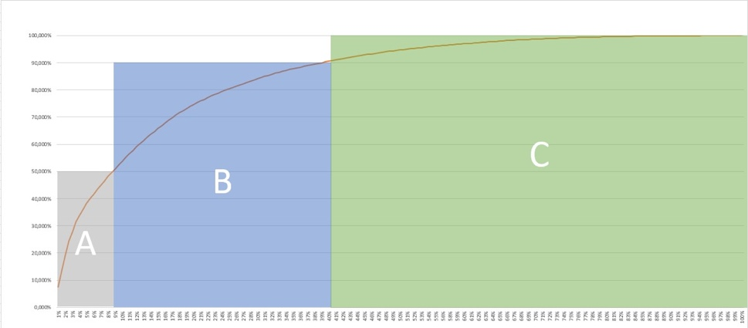
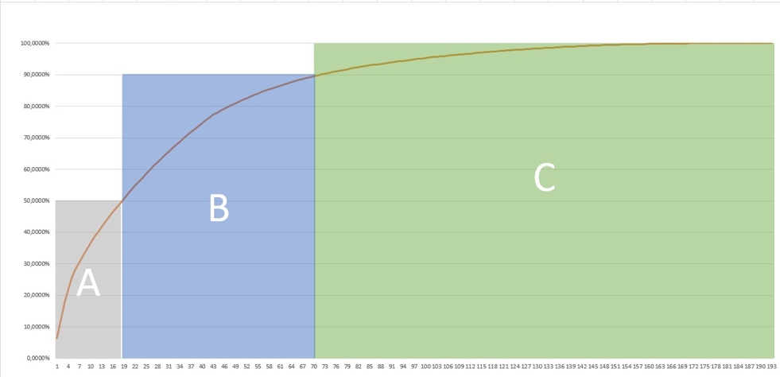
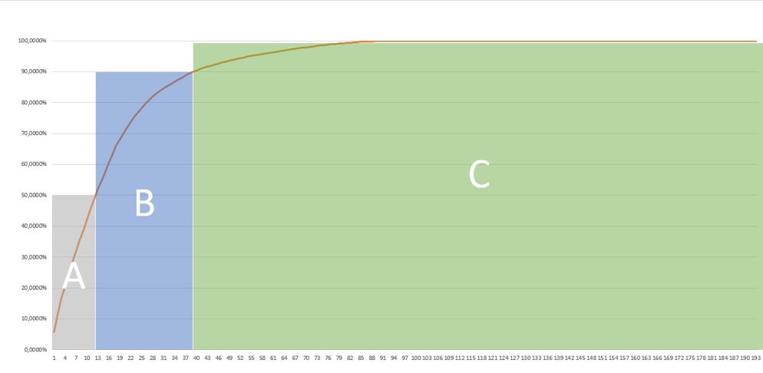
SYSTEM ANALYSIS
MICRO
ABC (Pareto) Analysis
Collected Data
Part Number | 12.05.2023 | 19.05.2023 | 26.05.2023 | 2.06.2023 | Other Weeks
X1 | 24 | 11 | 8 | 9 | . . .
X2 | 12 | 47 | 24 |  | . . .
X3 | 24 | 12 | 36 | 12 | . . .
X4 | 35 | 20 |  | 42 | . . .
X5 | 9 | 24 | 55 | 48 | . . .
X6 | 11 |  | 14 | 5 | . . .
X7 |  |  | 78 |  | . . .
. . | . . | . . | . . | . .
2023
2022
2021
2022-2023 Spring - IE 4920 - Group 9 – A Warehouse Decision Support System for Totomak

Slide 6
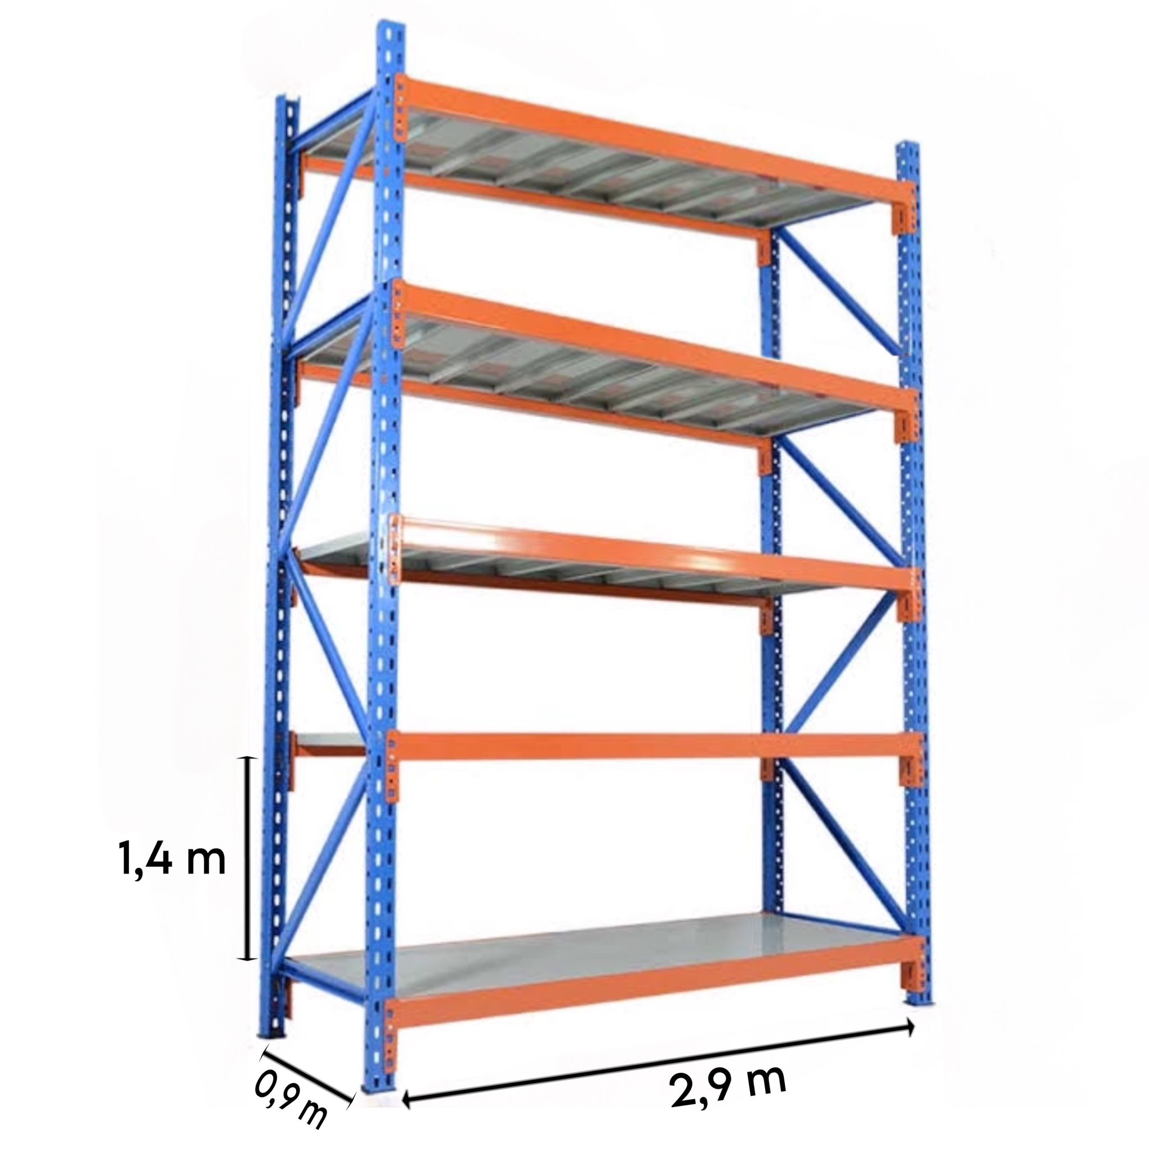

SYSTEM ANALYSIS
MICRO
a New Warehouse Layout
Layout→Distance Matrix (1320 locations)
A
B
Distance between A and B is 18m
Starting Point

Slide 7

PROBLEM DEFINITION
2022-2023 Spring - IE 4920 - Group 9 – A Warehouse Decision Support System for Totomak

Slide 8
PROBLEM DEFINITION
Symptoms
Fishbone Diagram
Data accessibility for analysis
Pick and place operations
No policy for picking like FIFO
Pick and place operations
are not scheduled
Random entry and exit of the products
Collected data are either not stored in an easy format or not accessable
Some required data are not collected
Work safety problems
It may cause the products to be kept in inventory for a long time and become deformed
Chaotic
warehouse
management!
Random use of locations
Redundant forklift movement
SKU locations are not monitored
Extra transport time
Not easy access to products
Unknown SKU locations
Manual Routing by the forklift operator
2022-2023 Spring - IE 4920 - Group 9 – A Warehouse Decision Support System for Totomak

Slide 9
LITERATURE REVIEW
Quadratic Assignment Problem
Assignment Problem
ABC Analysis (Pareto)
Warehouse
Thompson. G. L. (1981). A recursive method for solving assignment problems. In North-Holland Mathematics Studies (Vol. 59. pp. 319-343). North-Holland.
Konig. D. (1931). Graphok es matrixok [in Hungarian: Graphs and matrices]. Mat es Fizikai Lapok 38. 116-119.
Jacobi. C. G. (1890). De aequationum differentialum systemate non normali ad formam normalem revocando. . Vorlesungen über Dynamik von C. G. J. Jacobi nebstes fünf hinterlassenen Abhandlungen desselben . herausegegeben von A. Clesch. Berlin. Druck und Verlag von Georg Reimer. 1866. p. 550–578 et C.G.J. Jacobi's gesammelte Werke. fünfter Band. herausgegeben von K. Weierstrass. Berlin. Druck und Verlag von Georg Reimer. 1890. p. 485-513. (cf[I/67 a) et b)])
Douissa. M. R.. & Jabeur. K. (2016). A new model for multi-criteria ABC inventory classification: PROAFTN method. Procedia Computer Science. 96. 550-559
Nyman. D.. & Levitt. J. (2001). Maintenance planning. scheduling. and coordination. Industrial Press Inc.
Pareto. V. (1971). Manual of political economy.
Ng. W. L. (2007). A simple classifier for multiple criteria ABC analysis. European Journal of Operational Research. 177(1). 344-353.
Bragg. S. M. (2013). Inventory management. Colorado: Accounting Tools.
Ratliff. H. D.. & Rosenthal. A. S. (1983). Order-picking in a rectangular warehouse: a solvable case of the traveling salesman problem. Operations research. 31(3). 507-521.
Petersen. C. G.. & Schmenner. R. W. (1999). An evaluation of routing and volume‐based storage policies in an order picking operation. Decision Sciences. 30(2). 481-501.
Caron. F.. Marchet. G.. & Perego. A. (2000). Optimal layout in low-level picker-to-part systems. International Journal of Production Research. 38(1). 101-117.
Petersen. C. G.. & Aase. G. (2004). A comparison of picking. storage. and routing policies in manual order picking. International journal of production economics. 92(1). 11-19.
Li. W. J.. & Smith. J. M. (1995). An algorithm for quadratic assignment problems. European Journal of Operational Research. 81(1). 205-216.
Sahni. S.. & Gonzalez. T. (1976). P-complete approximation problems. Journal of the ACM (JACM). 23(3). 555-565.
Koopmans. T. C.. & Beckmann. M. (1957). Assignment problems and the location of economic activities. Econometrica: journal of the Econometric Society. 53-76.
Ji. P.. Lee. W. B.. & Li. H. (1997). A new algorithm for the assignment problem: An alternative to the Hungarian method. Computers & operations research. 24(11). 1017-1023
2022-2023 Spring - IE 4920 - Group 9 – A Warehouse Decision Support System for Totomak

Slide 10

MODELING APPROACH AND SOLUTION METHODS
2022-2023 Spring - IE 4920 - Group 9 – A Warehouse Decision Support System for Totomak

Slide 11
Our Approach
Tactical Level: Minimize total handling duration → shelf allocation: 6 months based on sales data + ABC
Operational Level: Minimize #Forklift sorties and total distance travelled for daily pick/place operations
Mathematical Modelling Based Decisions
Tactical Level: Shelf Allocation for 6 months based on sales data
Operational Level: Optimizing Forklift pick/place operations per day
MODEL 1
MODEL 2
2022-2023 Spring - IE 4920 - Group 9 – A Warehouse Decision Support System for Totomak

Slide 12
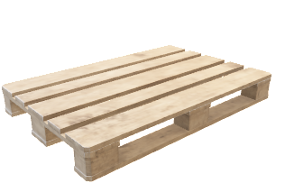
MODELING APPROACH & SOLUTION METHODS
Creating Parameters of Model 1
 | Demand: Weeks (Number Of Products)
Item | Week 1 | Week 2 | Week 3 | Week 4 | Week 5 | … | Week 26
X2 | 12 | 24 | 48 | 6 | 72 | … | 25
X3 | 48 | 12 | 36 | 60 | 84 | … | 43
X4 | 20 | 32 | 44 | 8 | 4 | … | 15
 | Demand: Weeks (Number of Pallets)
Item | Week 1 | Week 2 | Week 3 | Week 4 | Week 5 | … | Week 26
X2 | 2 | 4 | 8 | 1 | 12 | … | 20
X3 | 4 | 1 | 3 | 5 | 7 | … | 24
X4 | 5 | 8 | 11 | 2 | 1 | … | 18
Item | #products/pallet
X2 | 6
X3 | 12
X4 | 4
Production Lead time is one week!
Item | Max Weekly Demand | Safety Stock | Max ATP | Total Demand | Turnover
X2 | 12 | 3 | 15 | 27 | 1.8
X3 | 7 | 2 | 9 | 20 | 2.2
X4 | 11 | 3 | 14 | 27 | 1.9
2022-2023 Spring - IE 4920 - Group 9 – A Warehouse Decision Support System for Totomak

Slide 13
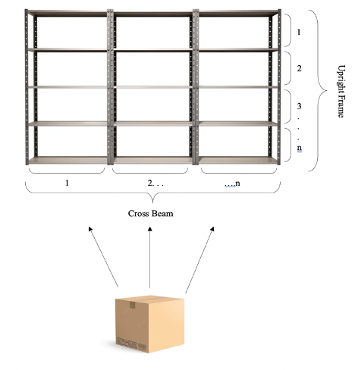
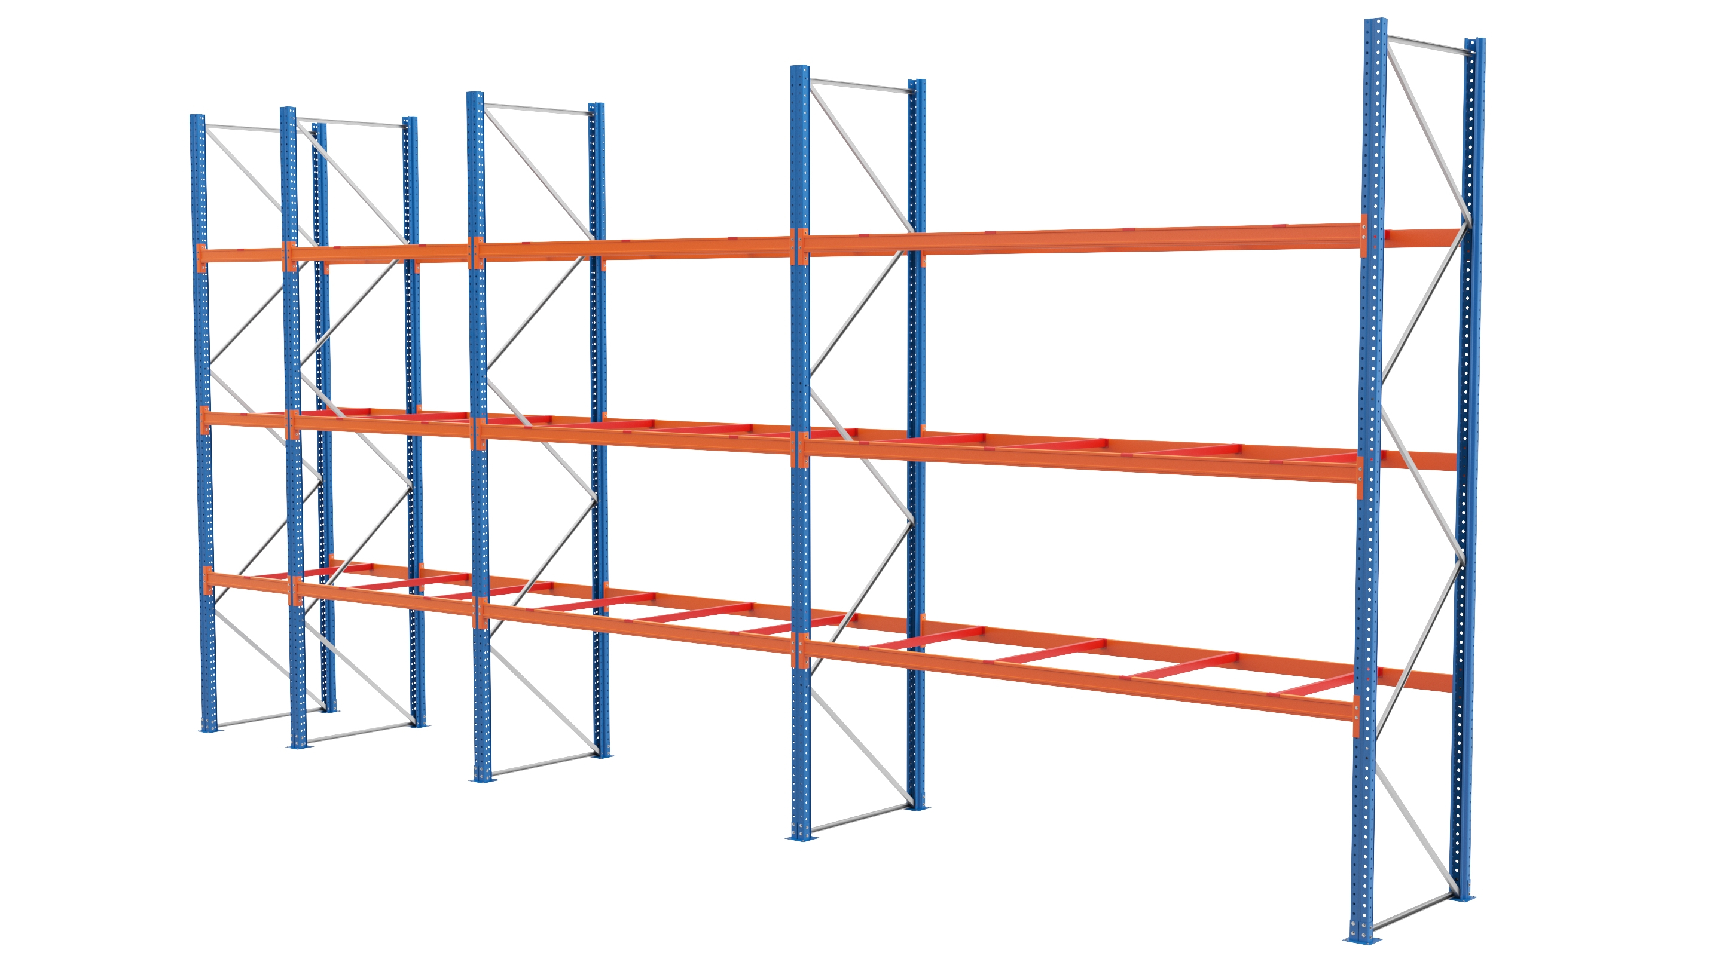
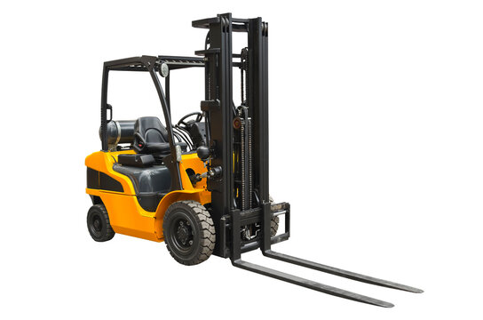

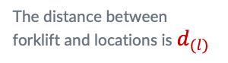
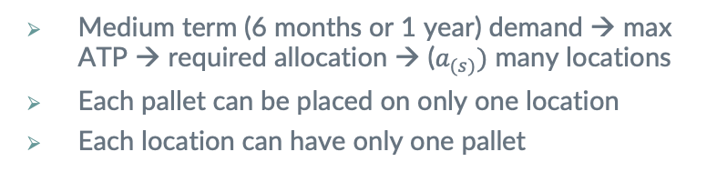
MODELING APPROACH & SOLUTION METHODS
Model 1
$d_{(l) }$= The distance between the base and the locations wrt forklift movements
The distance between
forklift and locations is $d_{(l) }$
Medium term (6 months or 1 year) demand → max ATP → required allocation → ($a_{(s)})$ many locations
Each pallet can be placed on only one location
Each location can have only one pallet
2022-2023 Spring - IE 4920 - Group 9 – A Warehouse Decision Support System for Totomak

Slide 14
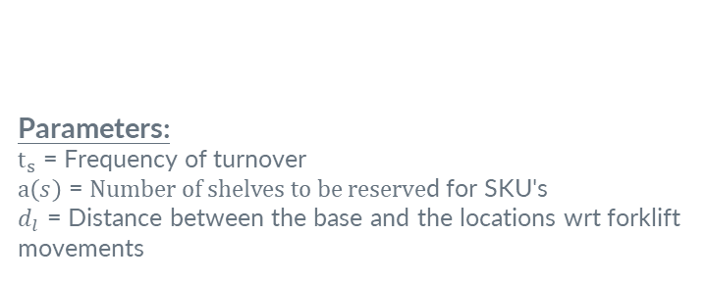
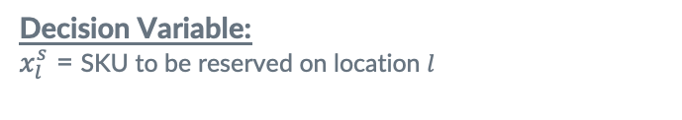
MODELING APPROACH & SOLUTION METHODS
Sets. Parameters and Decision Variables of Model 1
Parameters:
$t_{s}$ = Frequency of turnover
$a\left(s\right)$ = $Number of shelves to be reserve$d for SKU's
$d_{l}$ = Distance between the base and the locations wrt forklift movements
Set:
s = Stock Keeping Unit and s∈S={1,2.…...|S|}
Decision Variable:
$x_{l}^{s}$ = SKU to be reserved on location $l$
2022-2023 Spring - IE 4920 - Group 9 – A Warehouse Decision Support System for Totomak

Slide 15
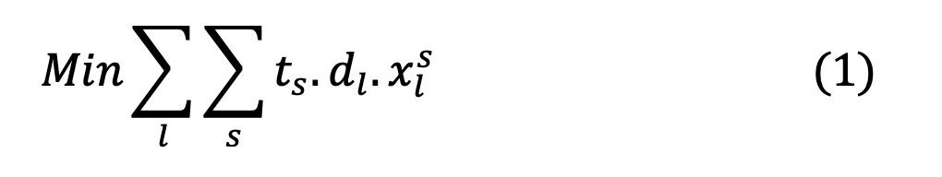
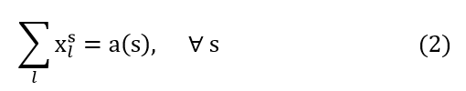
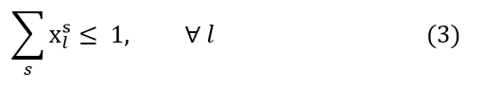
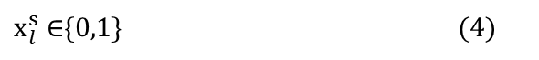
MODELING APPROACH & SOLUTION METHODS
Model 1
(1): The objective function optimizes the shelf locations of goods while minimizing the total distance required for forklift operations
(2): Shelf allocation
(3): At most one pallet per location
(4): Defines the range of decision variables
$x_{l}^{s}$ ∈{0,1} (4)
2022-2023 Spring - IE 4920 - Group 9 – A Warehouse Decision Support System for Totomak

Slide 16
MODELING APPROACH & SOLUTION METHODS
Transformation to an Assignment Problem
DISTANCE | 65 | 63.6 | 62.2 | 60.8 | 59.4
. .
102.1
TURNOVER | ITEM | SHELF NUMBER | 1 | 2 | 3 | 4 | 5
3.15789474 | X2 | 1 | 205.263158 | 200.842105 | 196.421053 | 192 | 187.578947
3.15789474 | X2 | 2 | 205.263158 | 200.842105 | 196.421053 | 192 | 187.578947
3.15789474 | X2 | 3 | 205.263158 | 200.842105 | 196.421053 | 192 | 187.578947
3.15789474 | X2 | 4 | 205.263158 | 200.842105 | 196.421053 | 192 | 187.578947
3.15789474 | X2 | 5 | 205.263158 | 200.842105 | 196.421053 | 192 | 187.578947
3.15789474 | X2 | 6 | 205.263158 | 200.842105 | 196.421053 | 192 | 187.578947
3.15789474 | X2 | 7 | 205.263158 | 200.842105 | 196.421053 | 192 | 187.578947
3.15789474 | X2 | 8 | 205.263158 | 200.842105 | 196.421053 | 192 | 187.578947
3.15789474 | X2 | 9 | 205.263158 | 200.842105 | 196.421053 | 192 | 187.578947
3.15789474 | X2 | 10 | 205.263158 | 200.842105 | 196.421053 | 192 | 187.578947
3.15789474 | X2 | 11 | 205.263158 | 200.842105 | 196.421053 | 192 | 187.578947
. .
1320
322.421053
322.421053
322.421053
322.421053
322.421053
322.421053
322.421053
322.421053
322.421053
322.421053
322.421053
. .
. .
. .
. .
. .
. .
. .
. .
. .
. .
. .
. .
. .
. .
. .
. .
. .
. .
. .
. .
0.0001 | DUMMY | 1320 | 0.0065 | 0.00636 | 0.00622 | 0.00608 | 0.00594
. .
0.01021

Slide 17
Heuristic
Items are sorted in descending order by the calculated turnover values.
And sorted items are cloned as many as their ATP values.
Then locations are sorted in ascending order.
Final step was matching the minimum distance with the cloned item which has maximum turnover.

Slide 18
MODELING APPROACH & SOLUTION METHODS
Comparison of Methods for Model 1
MODEL 1
OBJECTIVE FUNCTION | OBJECTIVE FUNCTION |  |  |  | TIME(CPU sec) | TIME(CPU sec)
PROBLEM | GPS | Hungarian | Heuristic | %GAP(H) | PROBLEM | GPS | Hungarian | Heuristic
1 | 4290.10 | 4290.10 | 4589.62 | 6.98% | 1 | 0.00235 | 0.00023 | 0.00171
2 | 11566.44 | 11566.44 | 12464.99 | 7.77% | 2 | 0.00211 | 0.00019 | 0.00179
3 | 7276.34 | 7276.30 | 7875.37 | 8.23% | 3 | 0.00017 | 0.00025 | 0.00131
4 | 4942.04 | 4942.04 | 5241.56 | 6.06% | 4 | 0.00268 | 0.00019 | 0.00156
5 | 16235.03 | 16235.03 | 17732.61 | 9.22% | 5 | 0.00267 | 0.00021 | 0.00131
6 | 5593.98 | 5593.98 | 5893.50 | 5.35% | 6 | 0.00224 | 0.00024 | 0.00176
7 | 12596.86 | 12596.86 | 13794.92 | 9.51% | 7 | 0.00178 | 0.00024 | 0.00155
8 | 14552.68 | 14552.68 | 15750.74 | 8.23% | 8 | 0.00121 | 0.00030 | 0.00189
9 | 19494.72 | 19494.72 | 20992.29 | 7.68% | 9 | 0.00317 | 0.00021 | 0.00162
10 | 19873.20 | 19873.20 | 21670.29 | 9.04% | 10 | 0.00264 | 0.00023 | 0.00161
 |  |  |  | 7.81% | Average | 0.00210 | 0.00023 | 0.00161
 |  |  |  | 9.51% | Worst | 0.00317 | 0.00030 | 0.00189
All codes were executed on Acer nitro i7 9th generation 16gb ram and based on the conducted experiments, pandas, scipy, numpy libraries are used in python code.
Toy instances: 10 item 100 locations.
2022-2023 Spring - IE 4920 - Group 9 – A Warehouse Decision Support System for Totomak

Slide 19
Our Approach
Tactical Level: Minimize total handling duration → shelf allocation: 6 months based on sales data + ABC
Operational Level: Minimize #Forklift sorties and total distance travelled for daily pick/place operations
Mathematical Modelling Based Decisions
Tactical Level: Shelf Allocation for 6 months based on sales data
Operational Level: Optimizing Forklift pick/place operations per day
MODEL 1
MODEL 2
2022-2023 Spring - IE 4920 - Group 9 – A Warehouse Decision Support System for Totomak

Slide 20
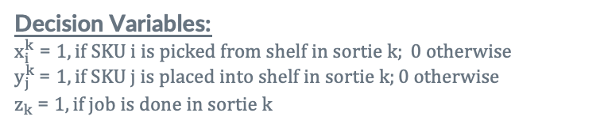
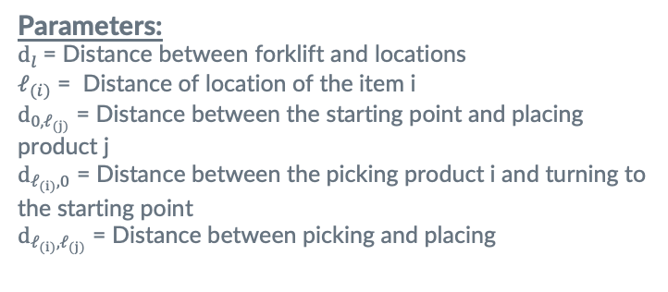
MODELING APPROACH
Sets. Parameters and Decision Variables of Model 2
Parameters:
$d_{l}$ = Distance between forklift and locations
$𝓁_{(i)}$ = Distance of location of the item i
$d_{0,𝓁_{(j)}}$ = Distance between the starting point and placing product j
$d_{𝓁_{(i)},0}$ = Distance between the picking product i and turning to the starting point
$d_{𝓁_{(i)},𝓁_{(j)}}$ = Distance between picking and placing
Sets:
s = Stock Keeping Unit and s∈S={1,2.…...|S|}
k = Number of sorties and k∈K={1,2... . |K|}
Decision Variables:
$x_{i}^{k}$ = $1, if SKU i is picked from shelf in sortie k; 0 otherwise$
$y_{j}^{k} \text{=}$ $1, if SKU j is placed into shelf in sortie k;0 otherwise$
$z_{k}$= $1, if job is done in sortie k$
2022-2023 Spring - IE 4920 - Group 9 – A Warehouse Decision Support System for Totomak

Slide 21
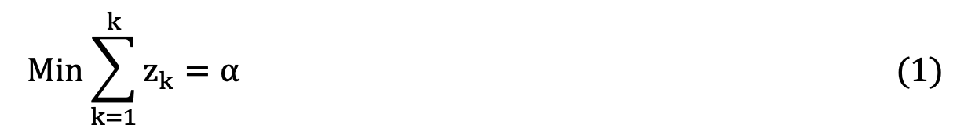
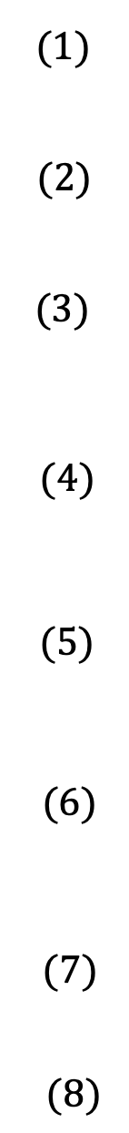
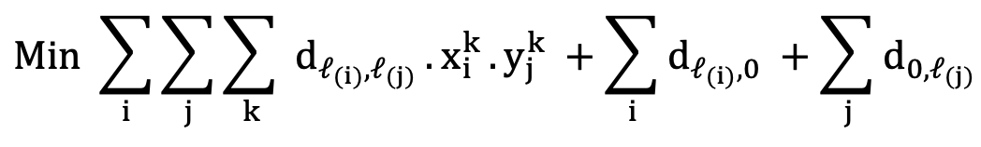
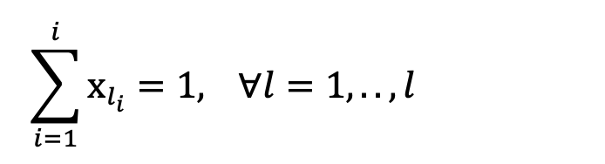
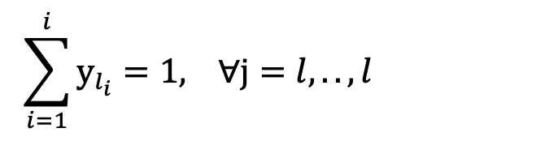
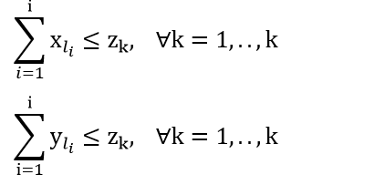
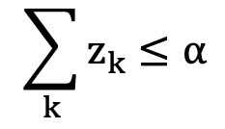
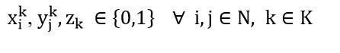
MODELING APPROACH
Model 2.1: QUADRATIC ASSIGNMENT
(1): Minimizes the number of sorties that must be done
(2): Minimizes the distance and time forklifts will take to pick and place the product
(3): Guarantees that at most one product will be picked for every sortie
(4): Guarantees that at most one product will be placed for every sortie
(5): Prevents redundant picking sortie to be done
(6): Prevents redundant placing sortie to be done
(7): Ensures that the minimum number of sorties is made
(8): Defines the range of decision variables
2022-2023 Spring - IE 4920 - Group 9 – A Warehouse Decision Support System for Totomak

Slide 22
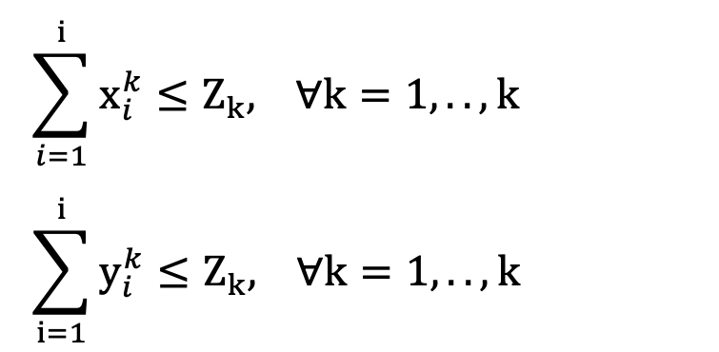
MODELING APPROACH
Model 2.1: QUADRATIC ASSIGNMENT
(1): Minimizes the number of sorties that must be done
(2): Minimizes the distance and time forklifts will take to pick and place the product
(3): Guarantees that at most one product will be picked for every sortie
(4): Guarantees that at most one product will be placed for every sortie
(5): Prevents redundant picking sortie to be done
(6): Prevents redundant placing sortie to be done
(7): Ensures that the minimum number of sorties is made
(8): Defines the range of decision variables
2022-2023 Spring - IE 4920 - Group 9 – A Warehouse Decision Support System for Totomak

Slide 23
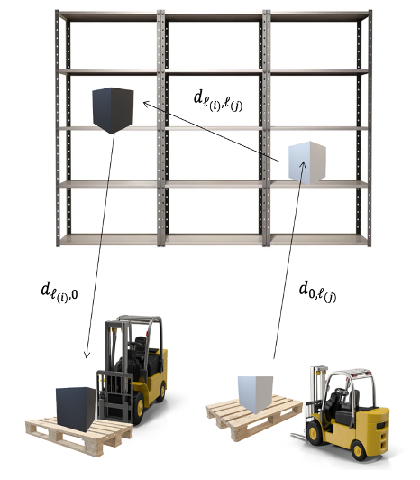
MODELING APPROACH & SOLUTION METHODS
Model 2
This model is about daily forklift operation optimization.
Only one product will be picked and placed.
In order to minimize the number of sorties, each product will be assigned to a sortie.
2022-2023 Spring - IE 4920 - Group 9 – A Warehouse Decision Support System for Totomak

Slide 24
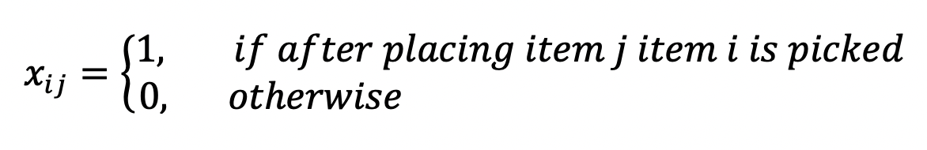
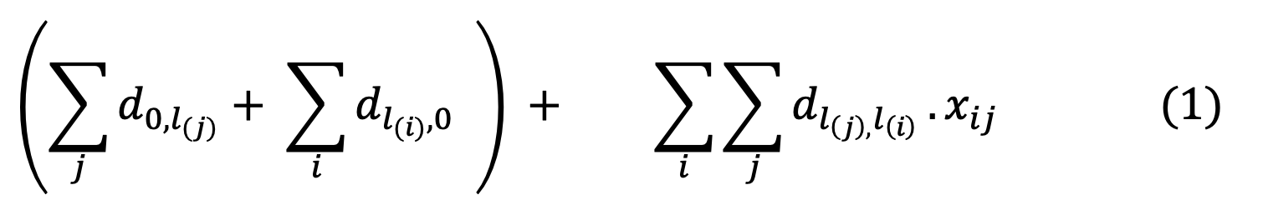
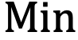
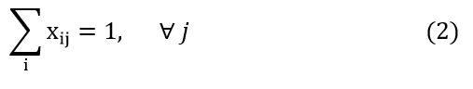
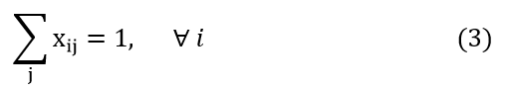
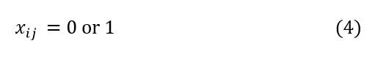
MODELING APPROACH
Model 2.2: LINEAR ASSIGNMENT
If we assign products to each other, not to sorties, the problem becomes linearized and becomes an assignment problem
Constant Distance
(1): Minimizes the distance that forklifts will take to pick and place the products.
(2): Guarantees that a product will be picked for every sortie.
(3): Guarantees that a product will be placed for every sortie.
(4): Range of the decision variable
2022-2023 Spring - IE 4920 - Group 9 – A Warehouse Decision Support System for Totomak

Slide 25
SOLUTION METHODS
Instance Generation: 10 pick + 10 place → 20 toy instances
According to FIFO
According to FIFO
PICKED | FULL CELLS RESERVED FOR ITEM |  |  | SHELVES REZERVED FOR ITEM
X62 | 44 | 33 | 43
X120 | 174 | 25 | 127 | 173
X65 | 249 | 304
X185 | 303 | 155 | 293 | 339 | 257
X110 | 384 | 256 | 292 | 200 | 246
. . | . . | . . | . . | . . | . .
PICKED
X62
X120
X65
X185
X110
. .
SELECTED SHELF LOCATION FOR PICKING
44
127
249
257
384
. .
 | 44 | 127 | 249 | 257 | 384
75 | 63 | 98.35 | 127.75 | 133.7 | 183.4
72 | 48.857 | 76.271 | 99.071 | 103.69 | 142.23
159 | 56.842 | 88.737 | 115.26 | 120.63 | 165.47
254 | 18 | 28.1 | 36.5 | 38.2 | 52.4
379 | 65.25 | 101.86 | 132.31 | 138.48 | 189.95
Randomly
PLACED | EMPTY CELLS RESERVED FOR ITEMS |  |  | SHELVES REZERVED FOR ITEM
X45 | 84 | 88 | 130 | 75
X61 | 164 | 72 | 36
X146 | 23 | 69 | 124 | 159 | 217
X71 | 300 | 254 | 382 | 336 | 428
X188 | 379 | 471
. . | . . | . . | . . | . . | . .
PLACED
X45
X61
X146
X71
X188
. .
RANDOMLY SELECTED CELLS LOCATION FOR PLACING
75
72
159
254
379
. .
2022-2023 Spring - IE 4920 - Group 9 – A Warehouse Decision Support System for Totomak

Slide 26
Heuristic
 | Y1 | Y2 | Y3 | Y4 | Y5 | Y6 | Y7 | Y8 | Y9 | Y10
X1 | 19.3333333 | 14 | 8.66666667 | 7.33333333 | 5.33333333 | 6.66666667 | 20 | 16 | 10 | 9.33333333
X2 | 2 | 4.66666667 | 8.66666667 | 18 | 12 | 10.6666667 | 2.66666667 | 2.66666667 | 7.33333333 | 8
X3 | 2.66666667 | 2.66666667 | 8 | 17.3333333 | 11.3333333 | 10 | 3.33333333 | 0.66666667 | 6.66666667 | 7.33333333
X4 | 13.3333333 | 8 | 2.66666667 | 6.66666667 | 3.33333333 | 0.66666667 | 14 | 10 | 8 | 3.33333333
X5 | 15.3333333 | 10 | 7.33333333 | 4.66666667 | 2.66666667 | 5.33333333 | 16 | 12 | 14 | 6.66666667
X6 | 24 | 18.6666667 | 14.6666667 | 8 | 10 | 12.6666667 | 24.6666667 | 20.6666667 | 21.3333333 | 14
X7 | 9.33333333 | 4 | 1.33333333 | 10.6666667 | 4.66666667 | 3.33333333 | 10 | 6 | 8 | 0.66666667
X8 | 16 | 13.3333333 | 10.6666667 | 4 | 6 | 8.66666667 | 16.6666667 | 15.3333333 | 17.3333333 | 10
X9 | 15.3333333 | 10 | 7.33333333 | 4.66666667 | 2.66666667 | 5.33333333 | 16 | 12 | 14 | 6.66666667
X10 | 23.3333333 | 18 | 12.6666667 | 3.33333333 | 9.33333333 | 10.6666667 | 24 | 20 | 14 | 13.3333333

Slide 27
SOLUTION METHODS
All codes were executed on Acer nitro i7 9th generation 16gb ram and based on the conducted experiments, pandas, scipy,numpy libraries are used in python code.
Toy instances: 10 item 100 locations.
Comparison of Methods for Model 2
MODEL 2
OBJECTIVE FUNCTION |  |  |  | TIME
PROBLEM | GPS | Hungarian | Heuristic | %GAP(H) | PROBLEM | GPS | Hungarian | Heuristic
1 | 61.33 | 61.33 | 65.33 | 6.58% | 1 | 0.0522 | 0.0087 | 0.0002
2 | 128.66 | 128.66 | 154.00 | 19.70% | 2 | 0.0109 | 0.0043 | 0.0002
3 | 88.66 | 88.66 | 106.00 | 19.64% | 3 | 0.0144 | 0.0032 | 0.0001
4 | 149.33 | 149.33 | 185.33 | 24.11% | 4 | 0.0183 | 0.0024 | 0.0003
5 | 108.66 | 108.66 | 108.67 | 0.01% | 5 | 0.0162 | 0.0035 | 0.0001
6 | 115.33 | 115.33 | 122.00 | 5.78% | 6 | 0.0223 | 0.0013 | 0.0002
7 | 82.66 | 82.66 | 84.00 | 1.62% | 7 | 0.0209 | 0.0077 | 0.0005
8 | 274.66 | 274.66 | 313.33 | 14.08% | 8 | 0.0135 | 0.0041 | 0.0001
9 | 95.33 | 95.33 | 99.33 | 4.20% | 9 | 0.0143 | 0.0076 | 0.0002
10 | 85.33 | 85.33 | 108.00 | 26.57% | 10 | 0.0301 | 0.0059 | 0.0002
11 | 148.00 | 148.00 | 172.00 | 16.22% | 11 | 0.0134 | 0.0082 | 0.0004
12 | 113.33 | 113.33 | 133.33 | 17.65% | 12 | 0.0194 | 0.0016 | 0.0002
13 | 113.33 | 113.33 | 120.00 | 5.89% | 13 | 0.0111 | 0.0028 | 0.0002
14 | 108.00 | 108.00 | 108.00 | 0.00% | 14 | 0.0186 | 0.0097 | 0.0002
15 | 68.00 | 68.00 | 69.33 | 1.96% | 15 | 0.0153 | 0.0044 | 0.0002
16 | 175.33 | 175.33 | 195.33 | 11.41% | 16 | 0.0125 | 0.0079 | 0.0002
17 | 165.33 | 165.33 | 178.67 | 8.07% | 17 | 0.0175 | 0.0077 | 0.0006
18 | 103.33 | 103.33 | 142.00 | 37.42% | 18 | 0.014 | 0.0065 | 0.0002
19 | 106.00 | 106.00 | 130.00 | 22.64% | 19 | 0.0137 | 0.0071 | 0.0002
20 | 93.33 | 93.33 | 110.67 | 18.58% | 20 | 0.0100 | 0.0016 | 0.0002
 |  |  |  | 13.11% | Average | 0.0179 | 0.0053 | 0.0003
 |  |  |  | 37.42% | Worst | 0.0522 | 0.0097 | 0.0006
2022-2023 Spring - IE 4920 - Group 9 – A Warehouse Decision Support System for Totomak

Slide 28
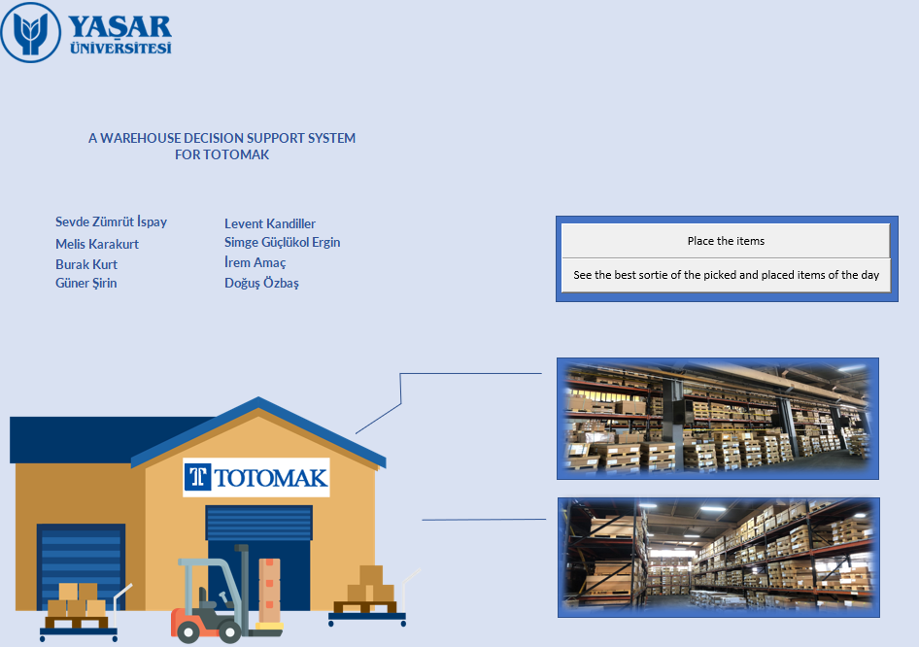
DECISION SUPPORT SYSTEM
2022-2023 Spring - IE 4920 - Group 9 – A Warehouse Decision Support System for Totomak

Slide 29
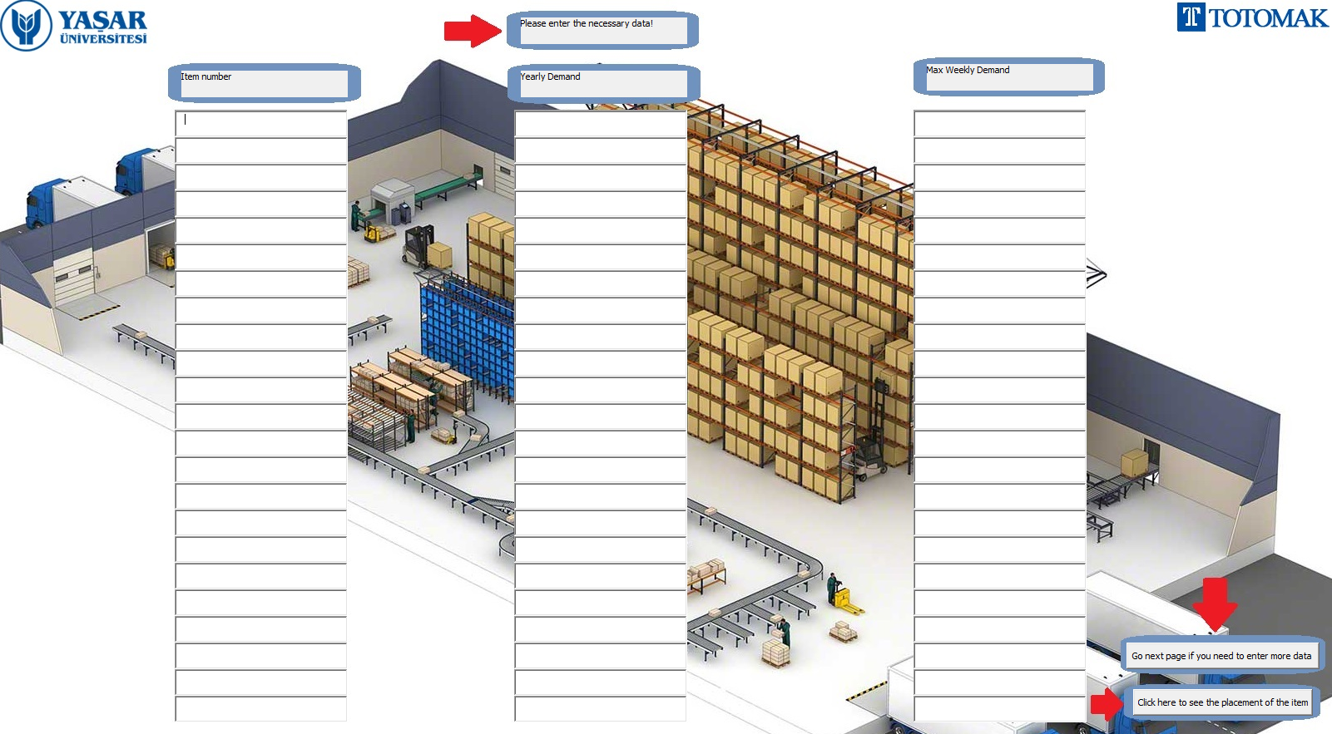

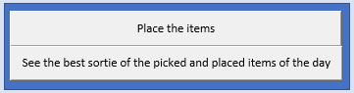
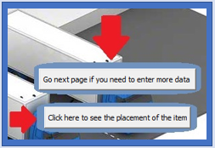
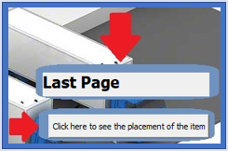
DECISION SUPPORT SYSTEM
Place the items
2022-2023 Spring - IE 4920 - Group 9 – A Warehouse Decision Support System for Totomak

Slide 30
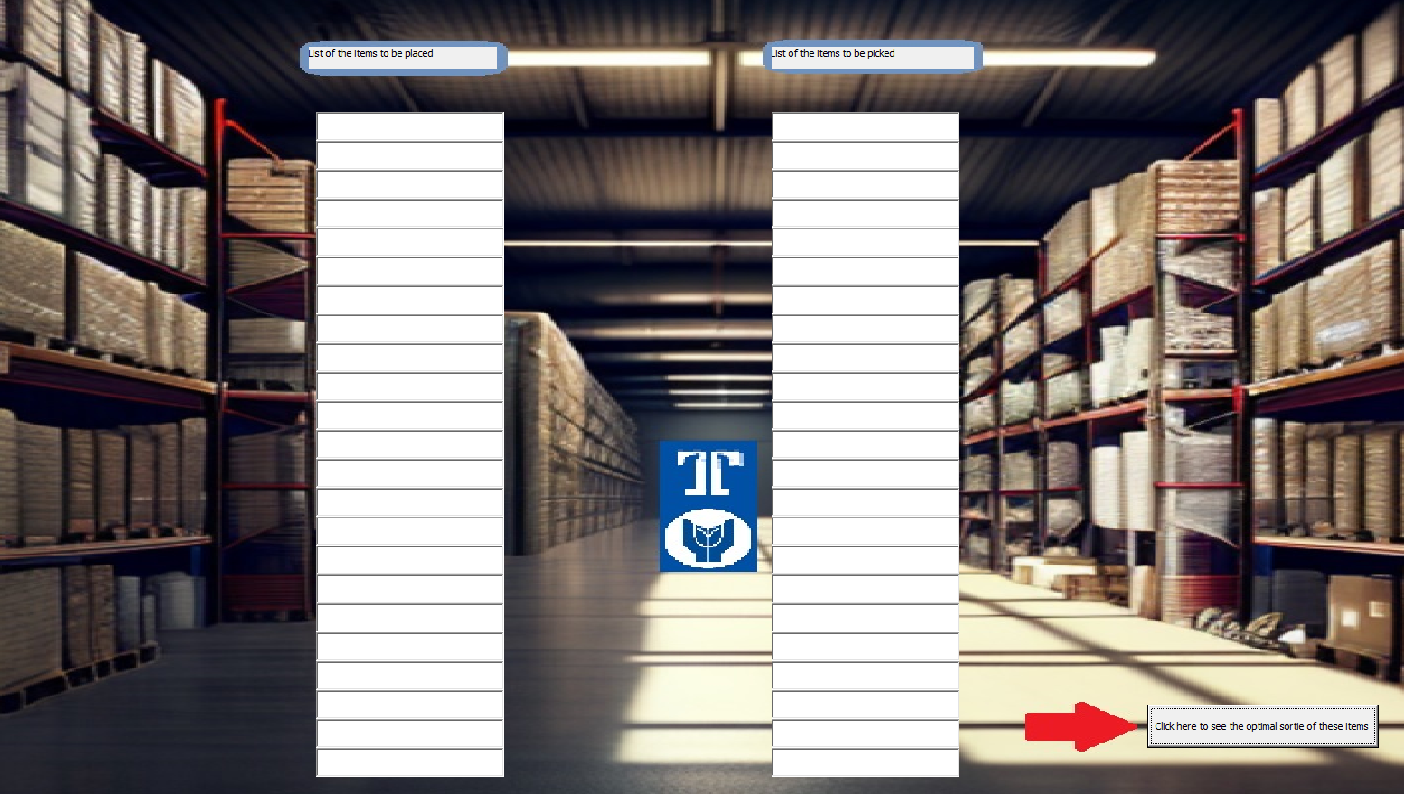
DECISION SUPPORT SYSTEM
See the best sortie of the picked and placed items of the day
2022-2023 Spring - IE 4920 - Group 9 – A Warehouse Decision Support System for Totomak

Slide 31

Model Base
Verification and Validation of the DSS: ᷉ 25 pick+25 place
 | TOTOMAK'S TOUR (m) | OUR TOUR (m) | DIFFERENCE | EFFICIENCY
DAY 1 | 6397 | 5123 | 1274 | 19.92%
DAY 2 | 6167 | 4981 | 1186 | 19.23%
DAY 3 | 4990 | 2992 | 1998 | 40.04%
DAY 4 | 6615 | 4009 | 2606 | 39.40%
DAY 5 | 6171 | 3682 | 2489 | 40.33%
DAY 6 | 6893 | 5067 | 1826 | 26.49%
DAY 7 | 6065 | 4112 | 1953 | 32.20%
DAY 8 | 6778 | 6011 | 767 | 11.32%
DAY 9 | 4347 | 3781 | 566 | 13.02%
DAY 10 | 4322 | 3792 | 530 | 12.26%
DAY 11 | 6575 | 5137 | 1438 | 21.87%
DAY 12 | 7516 | 5568 | 1948 | 25.92%
DAY 13 | 6053 | 4843 | 1210 | 19.99%
DAY 14 | 4719 | 4140 | 579 | 12.27%
DAY 15 | 7960 | 5897 | 2063 | 25.92%
DAY 16 | 7982 | 7002 | 980 | 12.28%
DAY 17 | 3956 | 3440 | 516 | 13.04%
DAY 18 | 8454 | 6657 | 1797 | 21.26%
DAY 19 | 4877 | 4205 | 672 | 13.78%
DAY 20 | 4950 | 3779 | 1171 | 23.66%
DAY 21 | 6160 | 5177 | 983 | 15.96%
DAY 22 | 7144 | 5332 | 1812 | 25.36%
MINIMUM | 3956 | 2992 | 516 | 11.32%
MAXIMUM | 8454 | 7002 | 2606 | 40.33%
AVERAGE | 6141 | 4760 | 1380 | 22.07%
2022-2023 Spring - IE 4920 - Group 9 – A Warehouse Decision Support System for Totomak

Slide 32
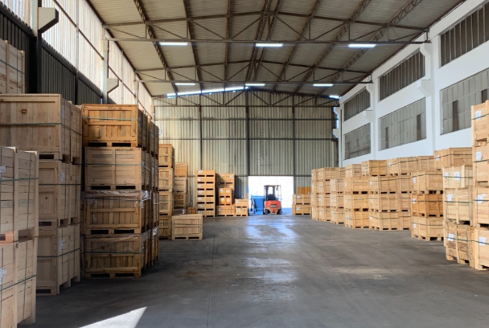
CONCLUSION
2022-2023 Spring - IE 4920 - Group 9 – A Warehouse Decision Support System for Totomak

Slide 33
Decision Support System (DSS)
Verification and Validation of the DSS
Comparison
Conclusion
Modeling Approach
Tactical and Operational Level Model Formulation
Problem Definition
Solution Methodology
Developing the Model Base
Fishbone Diagram
System Analysis
Macro/Micro
2022-2023 Spring - IE 4920 - Group 9 – A Warehouse Decision Support System for Totomak

Slide 34
Thanks!
Any questions?

